Slide 1
Unit-I
Overview of the C Language
Chapter 1-1
By: Ms.T.Anandhi, Guest Lecturer, Dept.Of Comp.Sci., Periyar Arts College,Cuddalore
Text book followed : Programming in ANCI C, E.Balagurusamy

Slide 2
Background
C is a structured programming language. It is considered a high-level language. It runs on many different hardware platforms.
Notes:
Developed early 1970’s

Slide 3
History of C
1960
ALGOL
International group
1967
BCPL
Martin Richards
1970
B
Ken Thompson
1972
Traditional C
Dennis Richie
1978
K & R C
Kemighan and Ritchie
1989
ANCI C
ANCI Committee
1990
ANCI/ISO C
ISO Committee
Notes:
Developed early 1970’s

Slide 4
Importance of C
>> Robust
>> Rich Built-in functions
>> Can write any complex program
>> Well suited for writing both system programs and business packages
>> Efficient and fast.
>> Has variety of data types and powerful operations.
>> Highly portable
>> Modular programming makes testing & debugging easier.
>> Can extend itself.
Notes:
Developed early 1970’s

Slide 5
Structure of C program

Slide 6
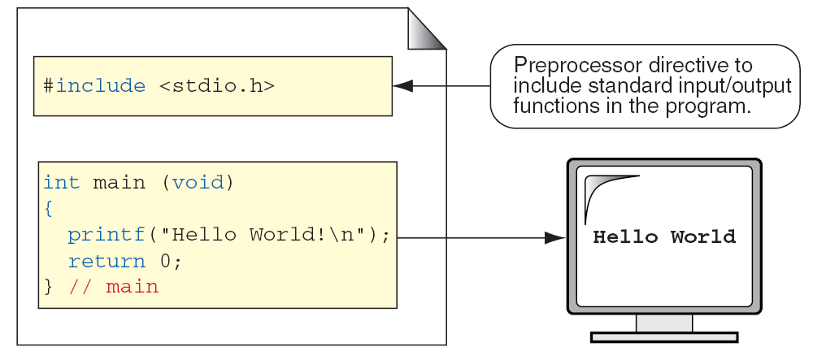
Sample program

Slide 7
Sample program

Slide 8
Programming Style
We must develop the habit of writing program in lower case
Braces are used to group the statements and mark the beginning and end of function or block.
Proper indentation of braces makes the program easier to read.
We may group statements together in one line . For Eg:
a=b; x=y+1; z=a+x;
5. Use comments wherever required. It makes better understanding.

Slide 9
Execution of C program
Create the source program.
Compiling the program into object code.
Linking the program with functions needed.
Executing the program
Whatever the Operating System(OS) The above steps are same.
(Operating System is a program which controls entire operation of the system. Two popular OS are Unix and MS-DOS.)

Slide 10
Unix System
1.Creating Program
a) Load Unix OS into memory
b) Call the editor by the command :ed <filename> or vi <filename>
c) Our C file is created in text editor ( The editor is: vi or ed).
d) Save the C file with valid name and with extension .c
(eg: program1.c, sample.c etc.,). It is called source program.
2. Compile & Linking:
To compile the program use command: cc <filename>
If no syntax error, the program is translated into object code & saved with the extension .o (Eg: sample.o).
b) Linking means putting together other files and functions needed.
c) Compiled and linked program is called executable object code.

Slide 11
Unix System-2
3. Executing the Program:
a) Program is executed by the command: a.out
Creating our own executable file:
a) When we compile a program a default name a.out is assigned.
b) To preserve the executable file we give our own name to that f file . Eg: mv a.out sample3
Multiple Source File:
To Combine multiple file we use : cc <file1> <file2>
Eg: cc sample.o trial.o
Eg: cc sample.c trial.o

Slide 12
MS_DOS System:
1. Creating Program
Create the program using word processing program.
Save the program with .c extension.
2. Compile & Linking:
Compiling Generates object code with .obj extension.
Compilation Command: MSC <filename>
Eg: MSC pay.c –generates object code named -pay.obj
Linking generates the executable file with .exe extension. Linking is done by the command: LINK <object file>
Eg: LINK pay.obj – generates executable code named – pay.exe
3. Executing the Program:
a) Type the file name to execute the command.
Eg: pay - will execute that program.

Slide 13
Constants, Variables & Data types
Chapter 1-2

Slide 14
Character Set
The characters of C are grouped into four categories.
1. Letters
Upper case: A,B,…Z
Lower Case: a,b,…z
2. Digits
Digits from 0,1,2…9.
3. Special Charcters
, ? ; : / & < + etc.,
4. White Spaces
Blank space, tab, new line etc.,

Slide 15
Character Set-2
Trigraph characters:
Some keyboards do not support certain characters. In that case Trigraph characters can be used.
Trigraph character is sequence of three characters (two question mark followed by another character) used to enter a character, if the character is not available in keyboard.
Eg: ??= means #
??( means [
??) means ]
??< means { etc.,

Slide 16
C Tokens
Smallest individual unit of a program is called token.
C tokens are of 6 types.
C Tokens
Keywords
Constants
Operators
Identifiers
Special
Symbols
Strings

Slide 17
Keywords & Identifiers
Every word of C program must be a keyword or an identifier.
Keywords: They are reserved words with fixed meaning.
Keywords are always written in lower case.
Eg: case, break, if, for etc.,
Identifiers: They are names of variables, arrays and functions.
First character should be an alphabet.
Uppercase and lowercase letters, digits and underscore are permitted.

Slide 18
Constants
Constants have fixed value that do not change during execution of program.
Its types are 1. Numeric constants 2. Character constants
1. Numeric constants
a)Integer constants
- Decimal (Eg: 123, -321, +788798)
- Octal (Eg: 037,0517,0426)
- Hexadecimal(Eg: 0X56, 0X34BC,0X9F)
b) Real constants
- Decimal notation (Eg: 0.00788, -89.234)
- Exponential notation (Eg: 12e-2,0.65e4)
0.000012 ➔ 12e-6

Slide 19
Constants-2
2. Character Constants
a) String Character Constants
- ‘F’ ‘5’ ‘:’
b) String Constants
- “Hello” “1978” “a+b”
Backslash Characters:
Backslash followed by a character is called escape sequence.
It is used in output function.
Eg: ‘\n’ means newline,
‘\a’ means audible bell sound.
‘\b’ means backspace

Slide 20
Variables & Rules for Variable names.
A variable name or identifier is used to store data value. A variable may take different values during execution of the program.
Rules for naming a variable:
An identifier must start with a letter or underscore:
it may have digits but not special characters.
Normally length of variable name should not be more than eight.
Keywords are not allowed as variable names.
WhiteSpace are not allowed.
Variable names are case-sensitive .

Slide 21
Examples of Valid and Invalid Names

Slide 22
Data Types
C is rich in data types. Its categories are
1. Primary Data types
2. Derived Data types
3. User-defined Data types.
Primary Data types are:
Void Type
Integral Type
Floating-Point Types

Slide 23
Data Types
Data Types
Integral
Floating point
Derived
Void
Integer
Character
Float
Double
Long Double
Signed
Unsigned

Slide 24
Character Types
Notes:
wchar_t is a wide character: The increased datatype size allows for the use of larger coded character sets. Width is compiler specific (not portable).

Slide 25
Integer Types
Note
sizeof (short) ≤ sizeof (int) ≤ sizeof (long) ≤ sizeof (long long)

Slide 26
Integer sizes
Typical Integer Sizes and Values for Signed Integers

Slide 27
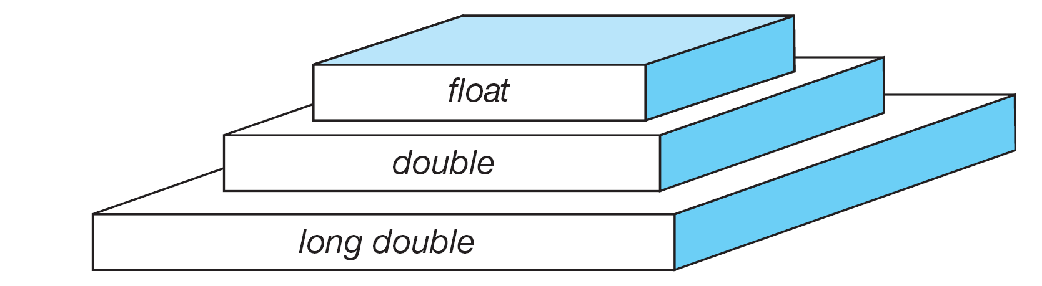
Floating-point Types
Note
sizeof (float) ≤ sizeof (double) ≤ sizeof (long double)

Slide 28
Declaring & Initializing Variables
Variables are named memory locations with the specified type.
1. Declaration of variable tells the compiler
(i). The Variable name and
(ii). The data type
Syntax: datatype v1,v2,v3,…vn;
Eg: : int i,sum;
double average;
2. Initialization of variables:
syntax: <datatype> <variable_name>=<value>;
Eg: int i=14;

Slide 29
Declaring variables of different types

Slide 30
User Defined Type Declaration
1. Type definition: Assigning new name to an existing data type.
Eg: typedef int units; ➔units symbolizes int
units batch1,batch2;➔declares batch1 and batch2 as integer type
2. enum:
syntax: enum <identifier> {<v1,v2…vn>};
Eg: enum days {Monday=1, Tuesday, Wednesday, Thursday, Friday}; ➔ assigns Monday to 1 and remaining constants are assigned as 2,3,4…

Slide 31
Declaration of storage classes
The storage class decides in which portion the variable can be recognized.
Global variable: Variable declared before main function
Local Variable: Variables declared within the function.
Storage classes are another qualifier of a variable. Its types are
auto- Local variable within a function
static- Local variable, but retain the value between function calls
extern-Global variable known to all functions.
register-Local variables stored in registers.

Slide 32
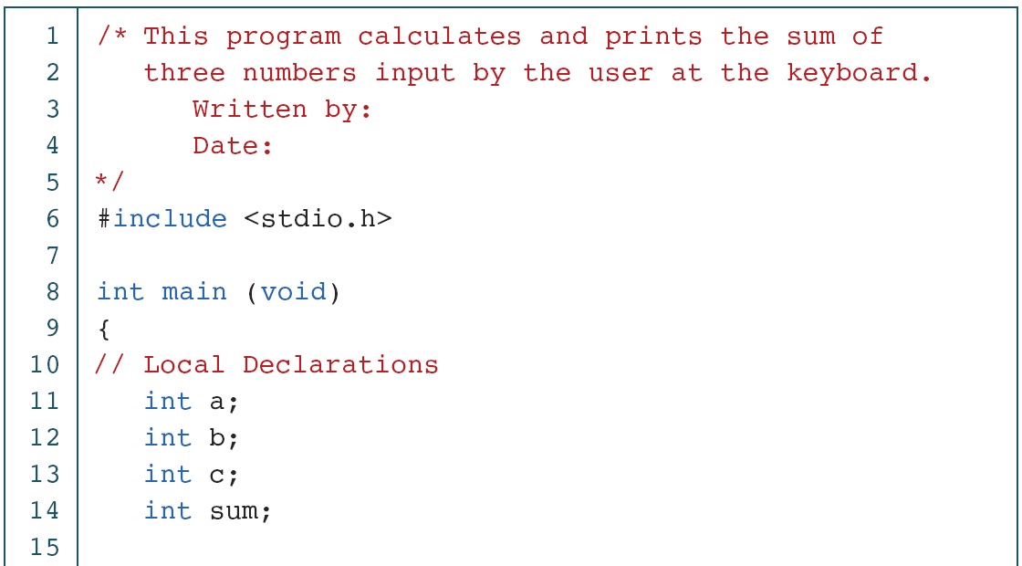
Sample program to print sum of 3 numbers

Slide 33
Sample program to print sum of 3 numbers(2)
PROGRAM 1-2
Print Sum of Three Numbers (continued)

Slide 34
Sample program to print sum of 3 numbers(3)

Slide 35
Assigning values to variables
Assignment statement:
Syntax:
variable=<value> or <expression>;
Eg: average=23;
average=total/5;
C permits multiple assignments in a line:
Eg: i=8; j=12;
Assigning value to variable at the time of declaration is called initialization.
Eg: int fact=1;

Slide 36
Reading data from keyboard
General scanf format:
scanf(“Control string”,&v1,&v2…);
Eg: scanf(“%d%d”,&i,&j);
The control string formats the input received from keyboard.
Similar concept is used in printf statement to write data.

Slide 37
Defining symbolic constant
#define:
While a constant used at multiple places we can define the value using #define. Eg: #define PI 3.14159
Modifiability;
While modifying the value of a constant we need not search all the occurrences. We can just modify in only one place.
Understandability:
The same number may give different meaning at different places. Assigning a value to symbolic constant can give better understanding.

Slide 38
Defining symbolic constant-Rules
1. Symbolic constant name follows the same rules as variable names.
2. # is the first character of define syntax.
3. No blank space between # and define keyword.
4. Blank space exists between define and name of constant.
5. Define statement does not end with semicolon.
6. Symbolic constant can not be assigned any other value.
(for eg - in other part of a program: MAX=120;
7. Symbolic constants are not declared of any data type.
8.Symbolic constant is defined anywhere in the program, but before the reference.

Slide 39
Declaring the variable as constant or volatile
Declaring a variable as constant:
const int pi=3.14;
The value of pi remains the same throughout the program and can not be changed.
Declaring a variable as volatile:
volatile int mark;
The value of mark can be changed any time by any external source.

Slide 40
Overflow and Underflow of data
The value of variable is either too big or too small to hold.
If a floating point value is too big it is rounded to specified significant digits.
Overflow results largest possible real value.
Underflow results 0.

Slide 41
Operators and Expressions
Chapter 1-3

Slide 42
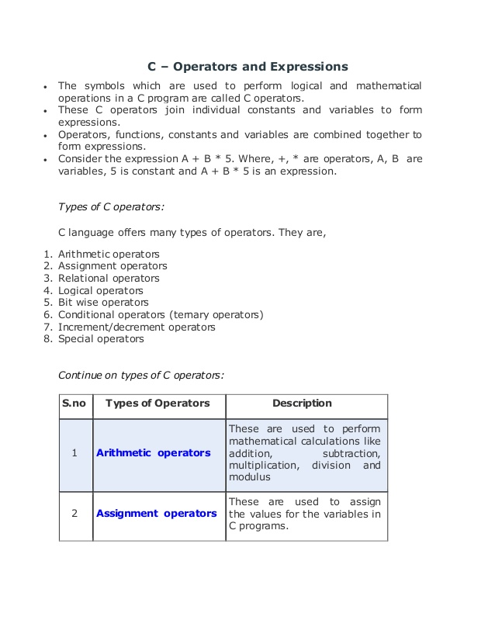
Operators
Operator is a symbol that tells the compiler to perform certain mathematical or logical manipulations.

Slide 43
Operators

Slide 44
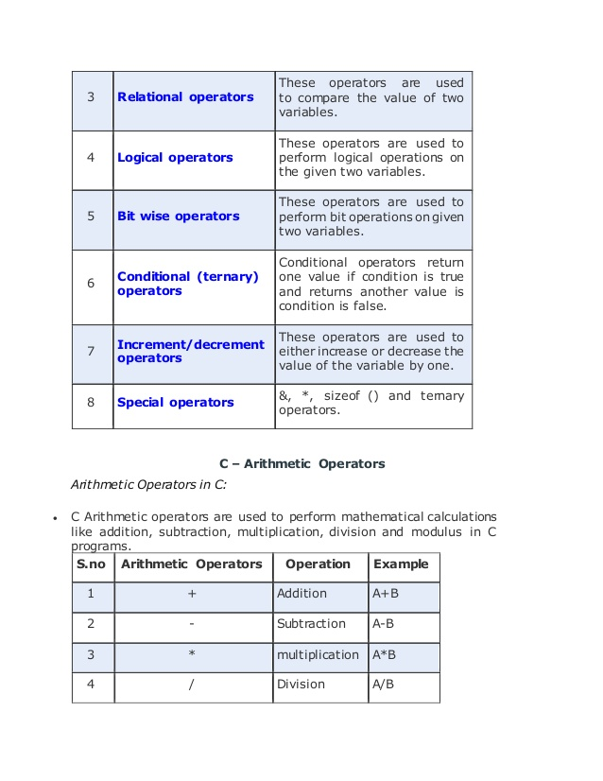
Operators

Slide 45
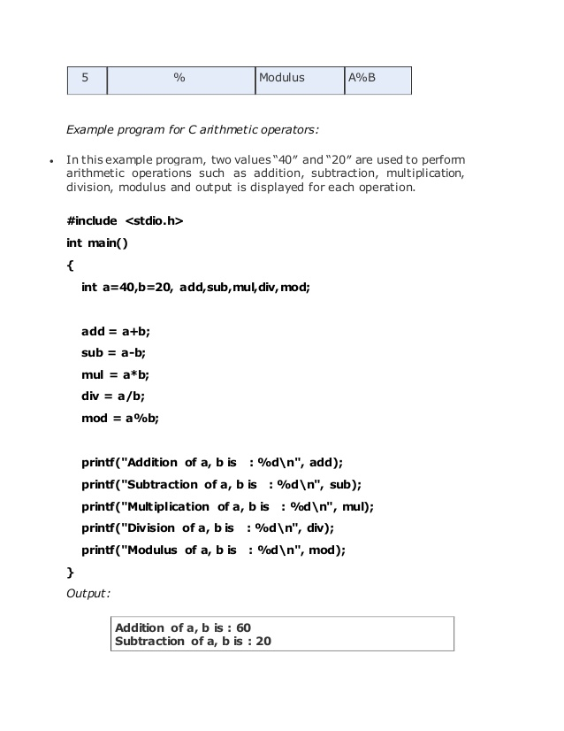
Arithmetic Operators

Slide 46
Example program for Arithmetic operators

Slide 47
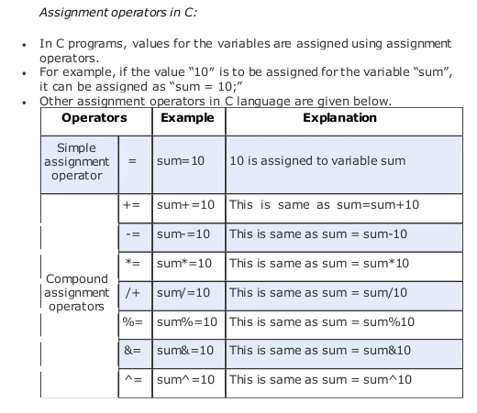
Assignment Operators

Slide 48
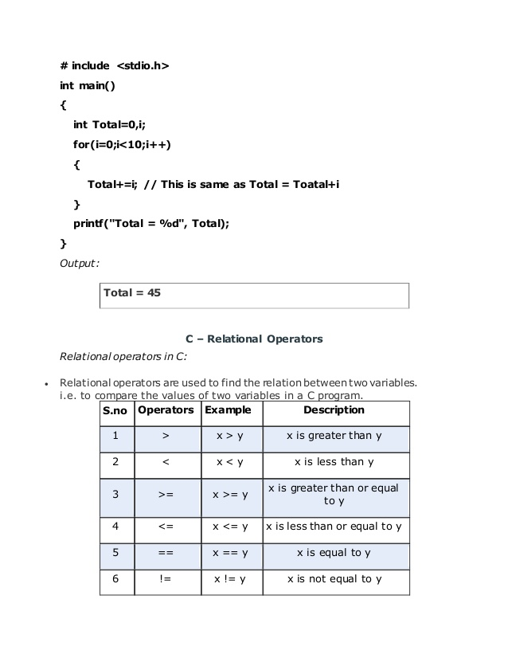
Example program for Assignment Operators

Slide 49
Relational Operators

Slide 50
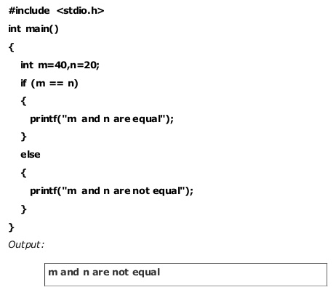
Example program for Relational Operators

Slide 51
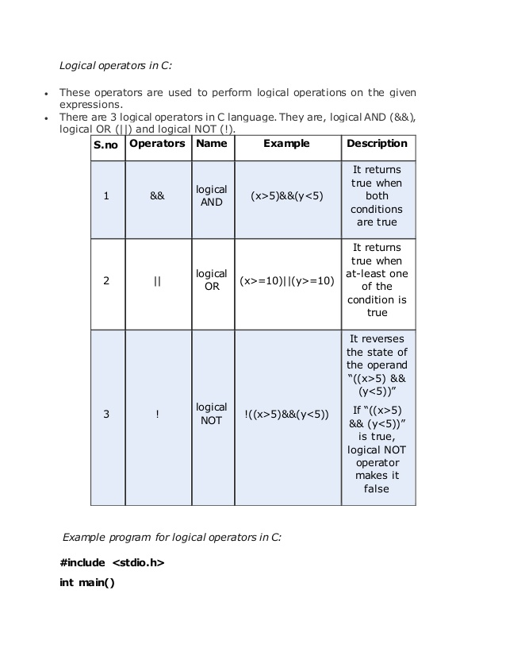
Logical Operators

Slide 52
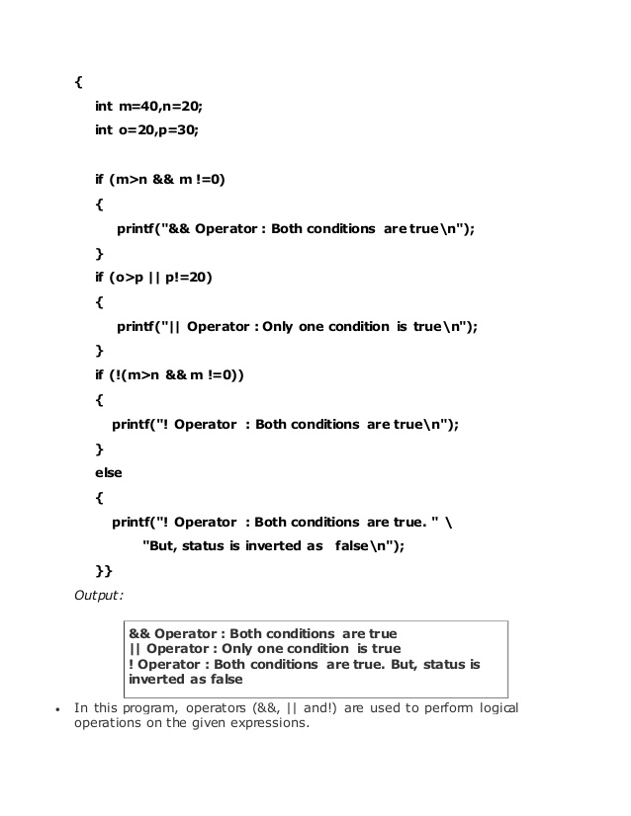
Logical Operators-2

Slide 53
Example program for Logical Operators

Slide 54
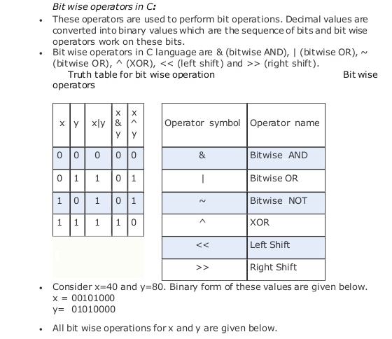
Bitwise Operators

Slide 55
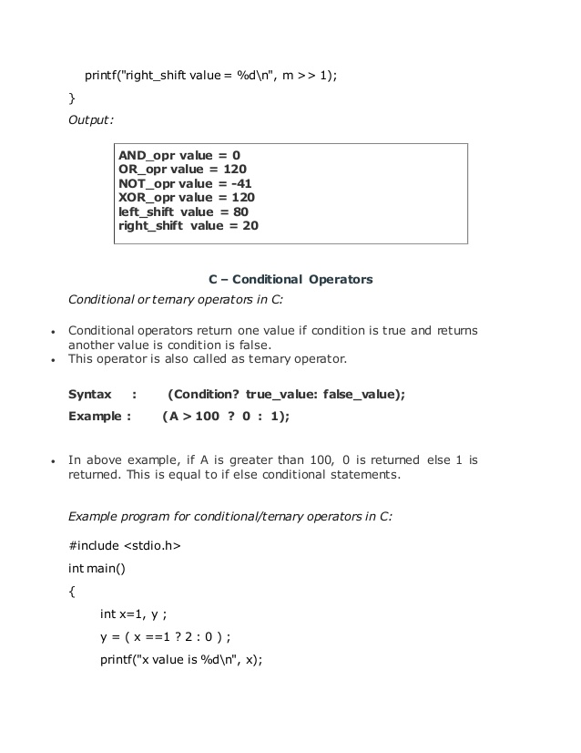
Conditional / Ternary Operators

Slide 56
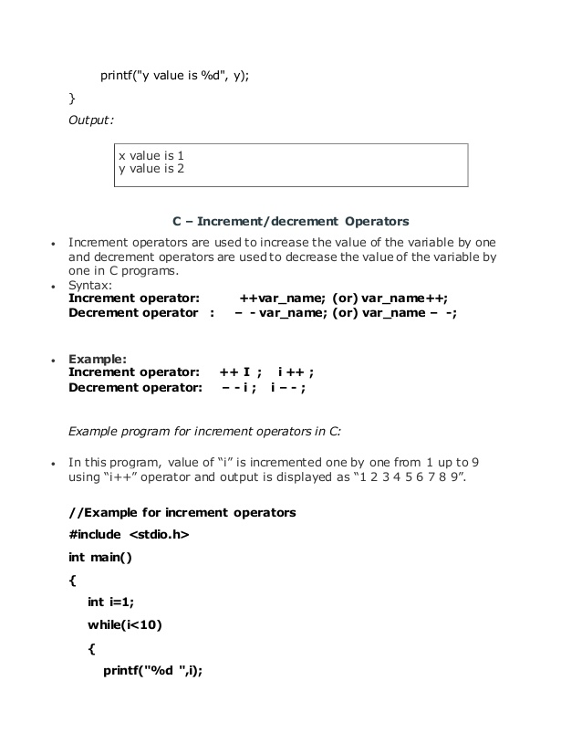
Example for Conditional / Ternary Operators

Slide 57
Increment / Decrement Operators
Eg1- preincrement:
m=5;
y=++m; ➔ m is incremented by 1 and y is assigned 6
Eg2-postincrement:
m=5;
y=m++;➔ y is assigned 5, then m is incremented by 1

Slide 58
Special Operators
Comma operator – links relative expressions together
Eg: value=(x=10,y=12,x+y)
Value of Rightmost expression is the value of overall expression.
sizeof – returns number of bytes the operand occupies.
Eg: sizeof(sum);
sizeof(long int);
& * - Pointer operator.
-> . - member selection operator

Slide 59
Arithmetic Expressions & Evaluation of Expression
Arithmetic expression is a combination of variables, constants and operators.
Eg: a*b+c
(m+n)/(x*2)
Evaluation of Expression:
The expression is evaluated first .
The result replaces the value of the variable in the left side.
Eg: x= a+b*c;

Slide 60
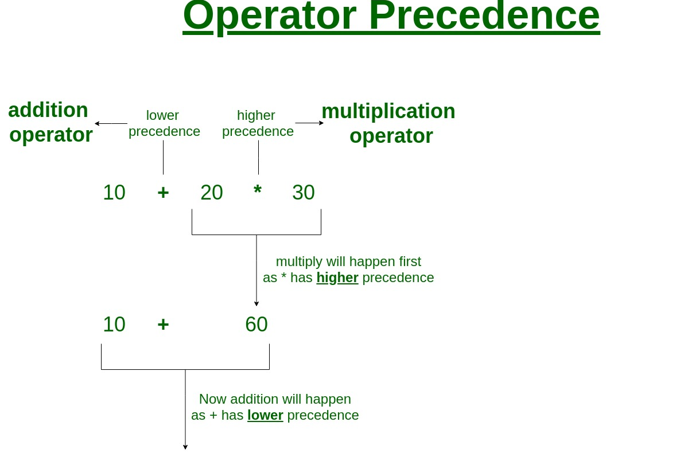
Operator Precedence

Slide 61
Some Computational Problems
Approximation Error:
Floating point value gives only approximations. Errors due to the approximation sometimes leads to serious problems.
Eg: a=1.0/3.0;
b=a*3.0;
It is not guaranteed that b will be 1, because of the approximation.
Divide by zero:
When we try to divide a number by zero will result abnormal termination or meaningless error.

Slide 62
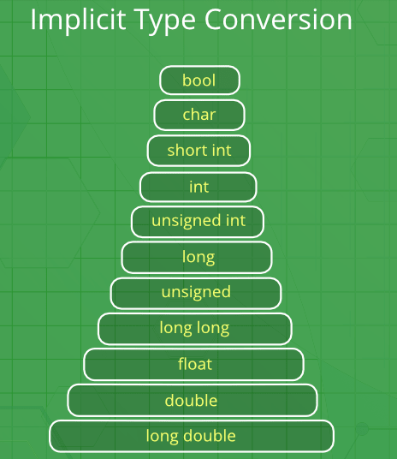
Type Conversions in Expressions
Conversion from one type to another are of two types.
1.Implicit Conversion
Implicit conversion always convert lower data type into higher one.
2. Explicit Conversion
Explicit conversion can be used to convert higher data type into lower type.

Slide 63
// An example of implicit conversion
#include<stdio.h>
int main()
{
int x = 10; // integer x
char y = 'a'; // character c
// y implicitly converted to int. ASCII
// value of 'a' is 97
x = x + y;
// x is implicitly converted to float
float z = x + 1.0;
printf("x = %d, z = %f", x, z);
return 0;
}
Implicit Conversions Example

Slide 64
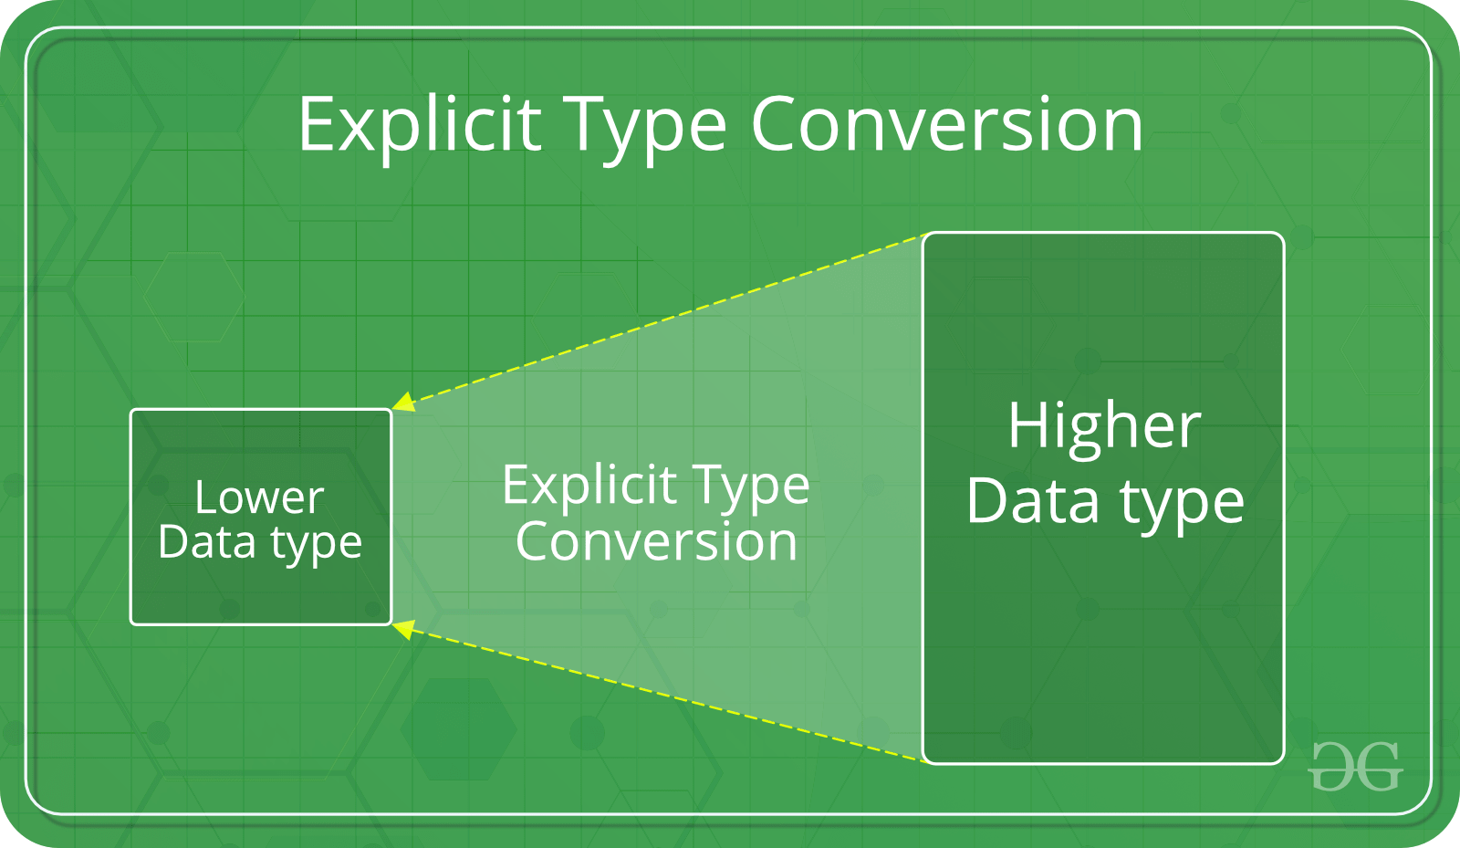
Explicit Conversions Example
#include<stdio.h>
int main()
{
double x = 1.2;
//Explicit Conversion
int sum = (int)x + 1;
printf("sum = %d", sum);
return 0;
}

Slide 65
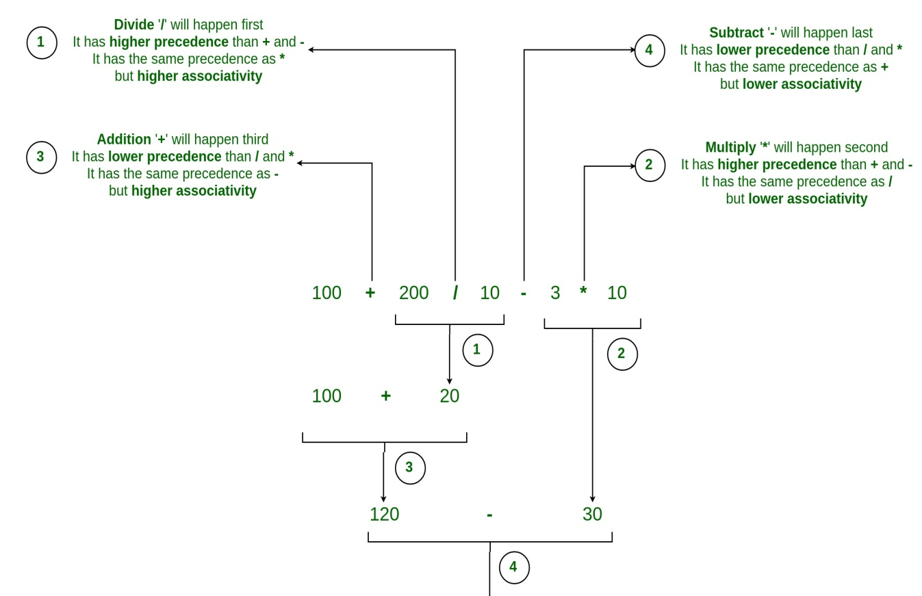
Operator precedence and associativity
/ and * have same precedent, but Left to Right(LTR) associativity

Slide 66
Mathematical Functions
acos(x) - Arc cosine of x
asin(x) - Arc sine of x
atan(x) - Arc tangent of x
cos(x) - cosine of x
sin(x) - sine of x
tan(x) - tangent of x
cosh(x) - Hyperbolic cosine of x
sinh(x) - Hyperbolic sine of x
tanh(x) - Hyperbolic tangent of x
ceil(x) - rounded up to the nearest integer
exp(x) - e to the x power
fabs(x) - absolute value of x
floor(x) - rounded down to the nearest integer.
fmod(x,y) - remainder of x/y
pow(x,y) - x to the power y
sqrt(x) - square root of x

Slide 67
THANK YOU

